Slide 1
RECITATION 5: Julia & Optimization
15.774/780 (Fall 2021)

Slide 2
Announcements
HW3 due today at 11:59pm
Case Study 2 prep due next Wed before class
Office hours change
Monday 5:00-6:00pm in E62-565 (Mohammad)
Wednesday 4:30-5:30pm in E51-242 (Ted)
Thursday 5:00-6:00pm in E62-575 (Doron)
Notes:
Write formulas on the board before class

Slide 3
Agenda
Intro to Julia
Linear optimization recap
JuMP & Gurobi
Notes:
Write formulas on the board before class

Slide 4
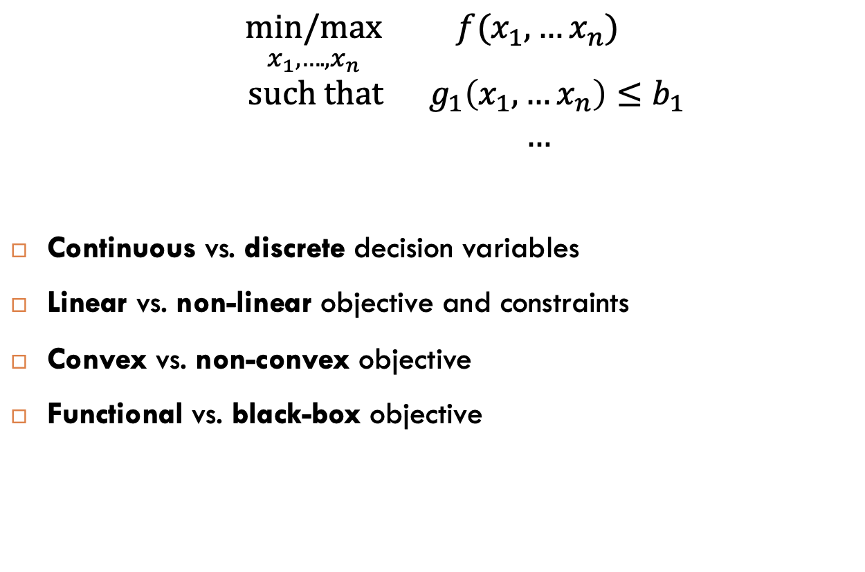
Welcome to my field…
$$\underset{x_{1}, ….,x_{n}}{min/max}{ f(x_{1}, …x_{n})}$$
$$such that{ g}_{1}\left(x_{1}, …x_{n}\right)≤b_{1}$$
$$…$$
Continuous vs. discrete decision variables
Linear vs. non-linear objective and constraints
Convex vs. non-convex objective
Functional vs. black-box objective
Decision variables
2. Objective
3. Constraints
In this class
Notes:
Write formulas on the board before class

Slide 5
Optimization recipe
Define your decisions variables.
Write your objective as a linear function.
Formulate your constraints.
Figure out how to solve it. Use Julia/JuMP/Gurobi.
Extract solution, objective value, shadow prices.
The Art of Operations Research
Notes:
Write formulas on the board before class

Slide 6
Magnetron Components Unlimited
Magnetron Components Unlimited manufactures microwaves:
What should MCU’s production plan be?
 | Full-Size | Compact
Manual Assembly Time (hrs) | 2 | 1
Electronic Assembly time (hrs) | 2 | 3
Maximum Demand | 220 | 130
Profit Margin | 120 | 130
500 hrs available
800 hrs available
Notes:
Write formulas on the board before class

Slide 7

Magnetron Components Unlimited
Magnetron Components Unlimited manufactures microwaves:
Define your decision variables:
$F=$ # of full-size ovens to produce (integer)
$C=$ # of compact ovens to produce (integer)
 | Full-Size | Compact
Manual Assembly Time (hrs) | 2 | 1
Electronic Assembly time (hrs) | 2 | 3
Maximum Demand | 220 | 130
Profit Margin | 120 | 130
500 hrs available
800 hrs available
Notes:
Write formulas on the board before class

Slide 8

Magnetron Components Unlimited
Magnetron Components Unlimited manufactures microwaves:
Write your objective as a linear function:
Maximize $120F + 130C$
 | Full-Size | Compact
Manual Assembly Time (hrs) | 2 | 1
Electronic Assembly time (hrs) | 2 | 3
Maximum Demand | 220 | 130
Profit Margin | 120 | 130
500 hrs available
800 hrs available
PROFIT
Notes:
Write formulas on the board before class

Slide 9

Magnetron Components Unlimited
Magnetron Components Unlimited manufactures microwaves:
Formulate your constraints:
$2F + C≤500$
$2F +3C≤800$
 | Full-Size | Compact
Manual Assembly Time (hrs) | 2 | 1
Electronic Assembly time (hrs) | 2 | 3
Maximum Demand | 220 | 130
Profit Margin | 120 | 130
500 hrs available
800 hrs available
MANUAL ASSEMBLY
ELECTRONIC ASSEMBLY
Notes:
Write formulas on the board before class

Slide 10

Magnetron Components Unlimited
Magnetron Components Unlimited manufactures microwaves:
Formulate your constraints:
$F≤220$
$C≤180$
 | Full-Size | Compact
Manual Assembly Time (hrs) | 2 | 1
Electronic Assembly time (hrs) | 2 | 3
Maximum Demand | 220 | 130
Profit Margin | 120 | 130
500 hrs available
800 hrs available
MAX SALES
Notes:
Write formulas on the board before class

Slide 11

Magnetron Components Unlimited
Magnetron Components Unlimited manufactures microwaves:
Formulate your constraints:
$F≥0$
$C≥0$
 | Full-Size | Compact
Manual Assembly Time (hrs) | 2 | 1
Electronic Assembly time (hrs) | 2 | 3
Maximum Demand | 220 | 130
Profit Margin | 120 | 130
500 hrs available
800 hrs available
CAN’T MAKE NEGATIVE UNITS
Notes:
Write formulas on the board before class

Slide 12
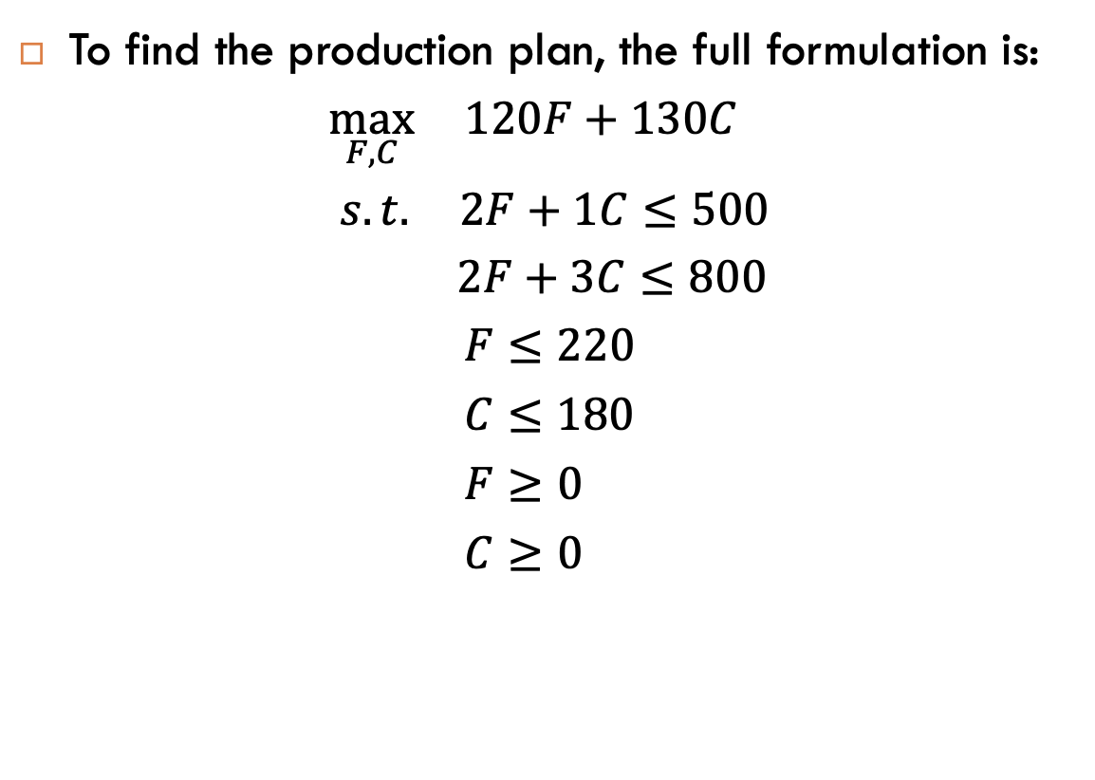
Magnetron Components Unlimited
To find the production plan, the full formulation is:
$$\max_{F,C}{ 120F+130C }$$
$$s.t{. 2F+1C≤500}$$
$$2F+3C≤800$$
$$F≤220$$
$$C≤180$$
$$F≥0$$
$$C≥0$$
PROFIT
MANUAL ASSEMBLY
ELECTRONIC ASSEMBLY
MAX SALES
CAN’T MAKE NEGATIVE UNITS
Notes:
Write formulas on the board before class

Slide 13
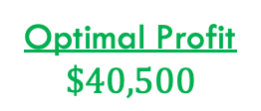

Magnetron Components Unlimited
To find the production plan, the full formulation is:
$$\max_{F,C}{ 120F+130C }$$
$$s.t{. 2F+1C≤500}$$
$$2F+3C≤800$$
$$F≤220$$
$$C≤180$$
$$F≥0$$
$$C≥0$$
PROFIT
MANUAL ASSEMBLY
ELECTRONIC ASSEMBLY
MAX SALES
CAN’T MAKE NEGATIVE UNITS
Optimal Solution
$$F^{∗}=175$$
$$C^{∗}=150$$
Optimal Profit
$$\$40,500$$
Julia
Notes:
Write formulas on the board before class

Slide 14
Shadow Prices
In linear programs, each constraint has a shadow price.
If I could increase right-hand-side by 1 unit…
How much would I improve my objective?
CAUTION:
Variables do not have shadow prices.
Constraints have shadow prices.
Think of constraints as related to resources. Their shadow price encodes the “marginal value” of that resource.
Notes:
Write formulas on the board before class

Slide 15
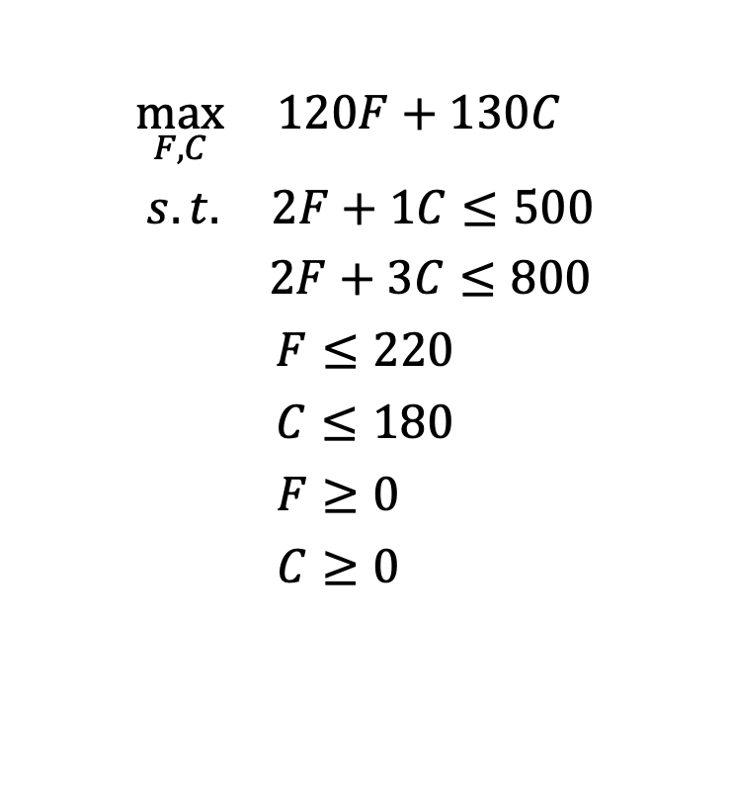
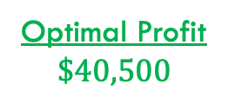
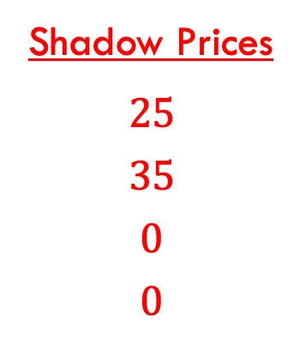

Magnetron Components Unlimited
$$\max_{F,C}{ 120F+130C }$$
$$s.t{. 2F+1C≤500}$$
$$2F+3C≤800$$
$$F≤220$$
$$C≤180$$
$$F≥0$$
$$C≥0$$
Shadow Prices
$$25$$
$$35$$
$$0$$
$$0$$
One more hour of manual assembly would increase my profit by $25.
Optimal Solution
$$F^{∗}=175$$
$$C^{∗}=150$$
Optimal Profit
$$\$40,500$$
Julia
Notes:
Write formulas on the board before class

